Slide 1
Looking at our Discrete Hankel Transform:
The reflection at each point k is calculated individually, so the difference between f values has no impact.
When we choose f we are choosing points to sample the “continuous” transform at.

Slide 2
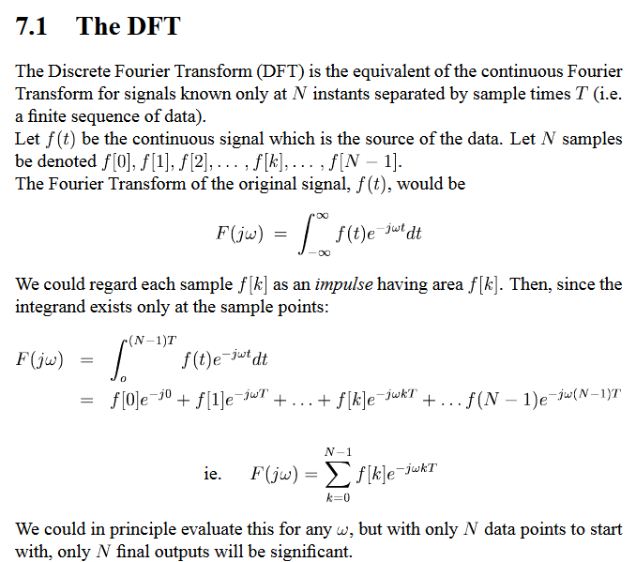

Slide 3
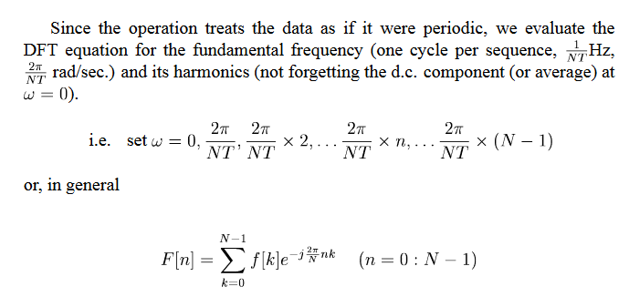

Slide 4
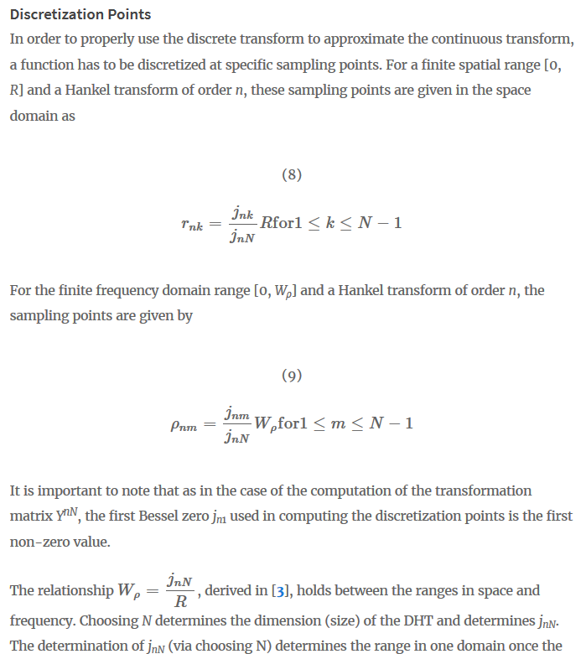

Slide 5
Baddour transform failed simple example

Slide 6
Frequency and space sampler also did not work

Slide 7
Transforms seem relatively invariant to frequency sampling methods
K =r * 2 * pi /M
K = 0:1:6

Slide 8
Transforms seem relatively invariant to frequency sampling methods
K = 0: 0.66 :10

Slide 9
Choosing f how I would for Fourier
f_n = 1/(N*T) * n

Slide 10
GPU and local match perfectly after matching parameters

Slide 11
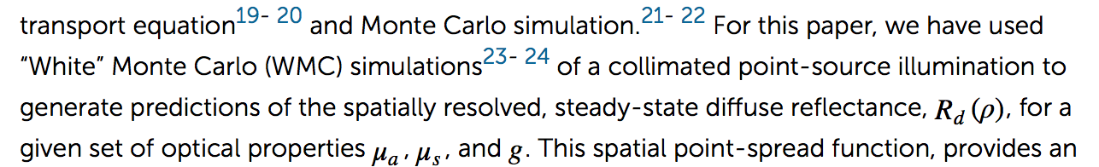
One parameter I haven’t accounted for
A detector numerical aperture of 0.22

Slide 12
One other issue
Distance_mm(1) = half of specified step size
Distance doesn’t start at 0!

